Slide 1
CS 4504 Parallel and Distributed Computation Spark
Kun Suo
Computer Science, Kennesaw State University
https://kevinsuo.github.io/

Slide 2

MapReduce
MapReduce: Divide the large task into multiple small tasks, and calculate separately for these small tasks, and then combine the results of each small task to get the calculation result of the large task

Slide 3
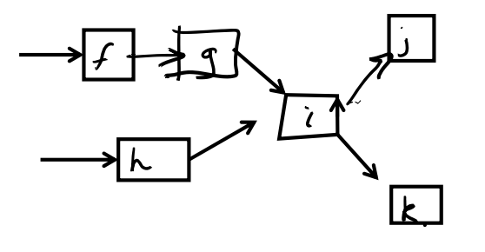
MapReduce Limitations
Static data
Restrictive programming model
No support for dataflows (not dynamic)
Purely batch processing (not flow)
Jobs can take hours to complete
No streaming, interactive analytics, real time requirement

Slide 4
Streaming Applications
Rise of real-time applications, such as network monitoring, sensor monitoring, AR / VR, audio and video data stream from live broadcast
Keywords: stream, real-time

Slide 5
Streaming Data
Streaming Data is data that is generated continuously by thousands of data sources, which typically send in the data records simultaneously, and in small sizes

Slide 6
Streaming Data Examples
Sensors in transportation vehicles, industrial equipment, and farm machinery send data to a streaming application. The application monitors performance, detects any potential defects in advance, and places a spare part order automatically preventing equipment down time.
A financial institution tracks changes in the stock market in real time, computes value-at-risk, and automatically rebalances portfolios based on stock price movements.
A real-estate website tracks a subset of data from consumers’ mobile devices and makes real-time property recommendations of properties to visit based on their geo-location.

Slide 7
Streaming Data Examples
A solar power company has to maintain power throughput for its customers, or pay penalties. It implemented a streaming data application that monitors of all of panels in the field, and schedules service in real time, thereby minimizing the periods of low throughput from each panel and the associated penalty payouts.
A media publisher streams billions of clickstream records from its online properties, aggregates and enriches the data with demographic information about users, and optimizes content placement on its site, delivering relevancy and better experience to its audience.
An online gaming company collects streaming data about player-game interactions, and feeds the data into its gaming platform. It then analyzes the data in real-time, offers incentives and dynamic experiences to engage its players.

Slide 8
The Characteristics of Streaming Data
Data arrives continuously and quickly as flowing water
Massive data scale, data volume can reach TB level or even PB level
High real-time requirements, the value of data will be greatly reduced over time
Data order cannot be guaranteed. The system cannot control the order of the data elements to be processed

Slide 9
Comparison between Batch Processing and Stream Processing
 | Batch processing | Stream processing
Data scope | Queries or processing over all or most of the data in the dataset. | Queries or processing over data within a rolling time window, or on just the most recent data record.
Data size | Large batches of data. | Individual records or micro batches consisting of a few records.
Performance | Latencies in minutes to hours. | Requires latency in the order of seconds or milliseconds.
Analyses | Complex analytics. | Simple response functions, aggregates, and rolling metrics.
Architecture | MapReduce | Storm, Kafka, etc.

Slide 10
How Stream Computing Works
Stream computing focuses on real-time. Once the data is generated, it will be processed immediately. When the data is processed, it will be serialized and stored in the cache, and then immediately transmitted to the next node through the network, and the next node will continue processing.

Slide 11
How Stream Computing Works
Stream computing for data processing, generally includes 3 steps:
Submit a streaming computing job
Load streaming data for stream computing
Continuously output the processed results
Step 1
Management node
Data forward
Step 2
Stream processing node
Stream processing node
Step 3
Data input
Stream processing node
Stream processing node
Data output

Slide 12
1. Submit a streaming computing job
Streaming computing job is a long live service in memory
The calculation logic must be defined in advance so that the stream computing knows how to process the data when received submission.
Processing logic for streaming computing cannot be changed during execution
Stream computing does not provide data storage services, so data that has been previously calculated cannot be recalculated
Step 1
Management node
Data forward
Step 2
Stream processing node
Stream processing node
Step 3
Data input
Stream processing node
Stream processing node
Data output

Slide 13
2. Load streaming data for stream computing
Once the streaming computing job starts, it will be in waiting state for the event to trigger.
Once the data enters the system, it will immediately execute the computing logic and output the results.
After the data is processed at one node, it will be forwarded to subsequent nodes for further processing according to predefined rules
Step 1
Management node
Data forward
Step 2
Stream processing node
Stream processing node
Step 3
Data input
Stream processing node
Stream processing node
Data output

Slide 14
3. Continuously output the processed results
After obtaining the calculation result of the small batch data, the streaming calculation job can output the corresponding result immediately, without waiting for the calculation result of the entire data.
The data will be discarded immediately after processed
Step 1
Management node
Data forward
Step 2
Stream processing node
Stream processing node
Step 3
Data input
Stream processing node
Stream processing node
Data output

Slide 15

Example of Streaming Systems
IBM InfoSphere Streams
Provide real-time data analysis services for investment banks, hedge funds, government agencies, etc.
Apache Storm by Twitter
https://storm.apache.org/
Puma by Facebook
Dstream by Baidu

Slide 16
Example of Streaming Systems: Storm
There are two kinds of nodes on the Storm cluster: Master Node and Worker Nodes.
A process called "Nimbus" runs on the master node. Nimbus is responsible for distributing code to the cluster, assigning tasks to worker nodes, and monitoring errors and faults.

Slide 17
Example of Streaming Systems: Storm
A daemon called "Supervisor" runs on each worker node.
Supervisor is responsible for monitoring the work assigned to the node, receiving tasks assigned by Nimbus, and starting and stopping worker processes based on requirements

Slide 18
Example of Streaming Systems: Storm
The interaction between the Master Node and the Worker Nodes is through ZooKeeper
Nimbus sends tasks or information to the ZooKeeper cluster, and then Supervisors gets tasks from the ZooKeeper cluster and starts worker processes to execute the tasks

Slide 19
Example of Streaming Systems: Storm
Every streaming task on Storm includes two parts:
Read data, and process task
Worker provides spout for reading data; bolt for processing tasks

Slide 20
Example of Streaming Systems: Storm
Every streaming task on Storm includes two parts:
Read data, and process task
Worker provides spout for reading data; bolt for processing tasks
The topology of spouts and bolts compose one streaming task

Slide 21
Example of Streaming Systems: Storm
Spout:
Used to receive source data.
Typically, Spout reads data tuples from an external data source and then sends them to the topology.

Slide 22
Example of Streaming Systems: Storm
Bolt:
Used to process the input data flow, such as data filtering, functions, aggregations, joins, database interactions, etc.
After data processing, a new stream may be output as input for the next Bolt.
Each Bolt often has only a single computing logic.

Slide 23
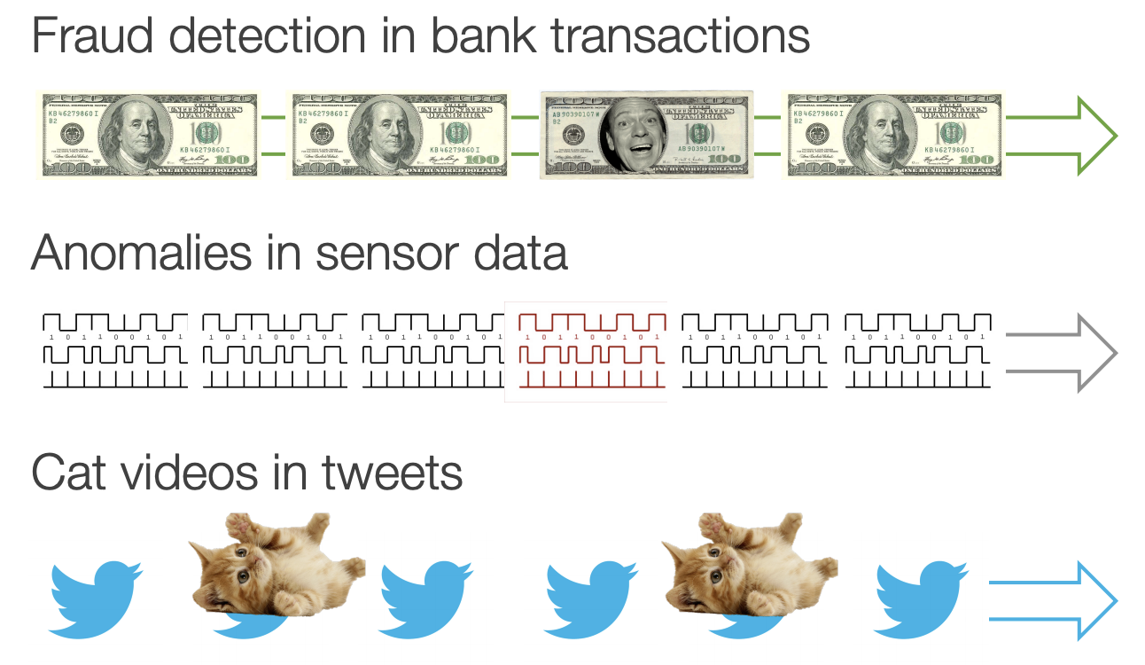
Example of Streaming Systems: Spark Streaming
Spark streaming is used for big streaming data processing

Slide 24
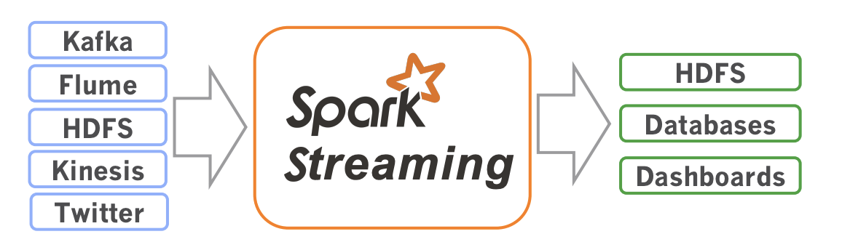
Example of Streaming Systems: Spark Streaming
Receive data streams from input sources, process them in a cluster, push out to databases dashboards
Scalable, fault-tolerant, second-scale latencies

